Slide 1
Dithering Images
FINE 204 Capstone Project
Kevin Haslett
Winter 2017

Slide 2
Background
History and Inspirations

Slide 3
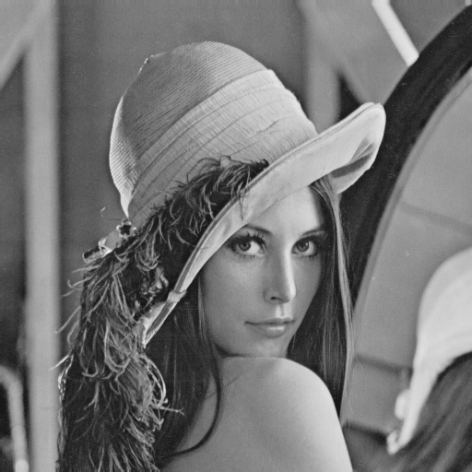
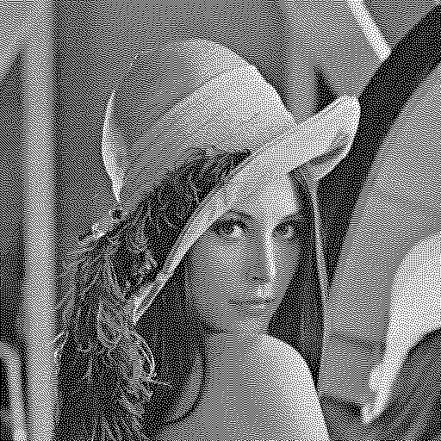
What is image dithering?
“Dither is an intentionally applied form of noise used to randomize quantization error, preventing large-scale patterns such as color banding in images.” (https://en.wikipedia.org/wiki/Dither)
In simpler terms, it’s a technique we use when reducing the colour palette of an image to make it look better to our eyes
i.e. Going from this (256 colour grayscale) to this (2 colour black and white)

Slide 4
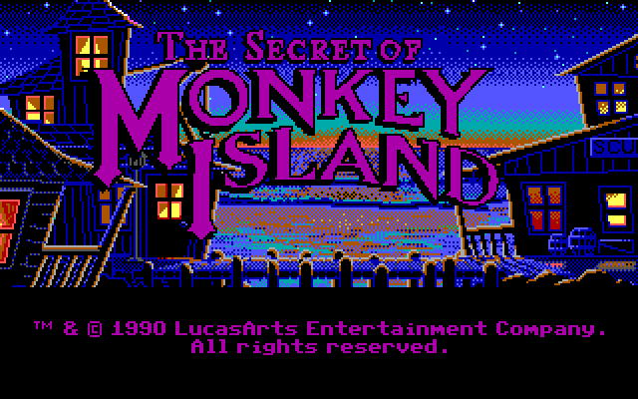
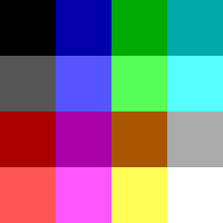
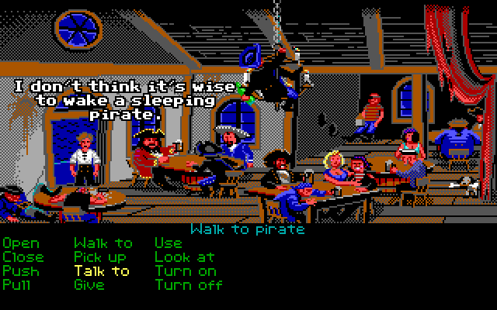
But why?
In modern computers we almost always use 24bit True Colour which allows us to use about 65 million colours
This wasn’t always the case, yet people were still making beautiful art for computers with a significantly smaller palette
Computer games like The Secret of Monkey Island (1990 Lucasfilm Games) used only the 16 colours from the EGA palette. (pictured here =>)
They used dithering (and the blurriness of CRT monitors) to blend the colours together and produce a broader range than they were given.

Slide 5
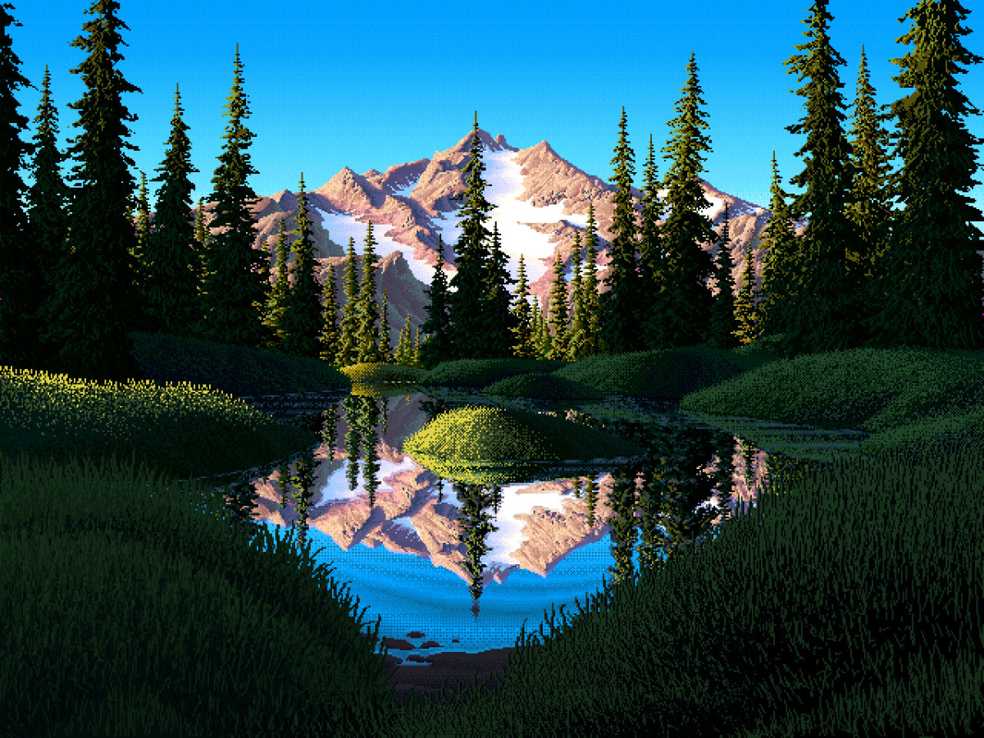
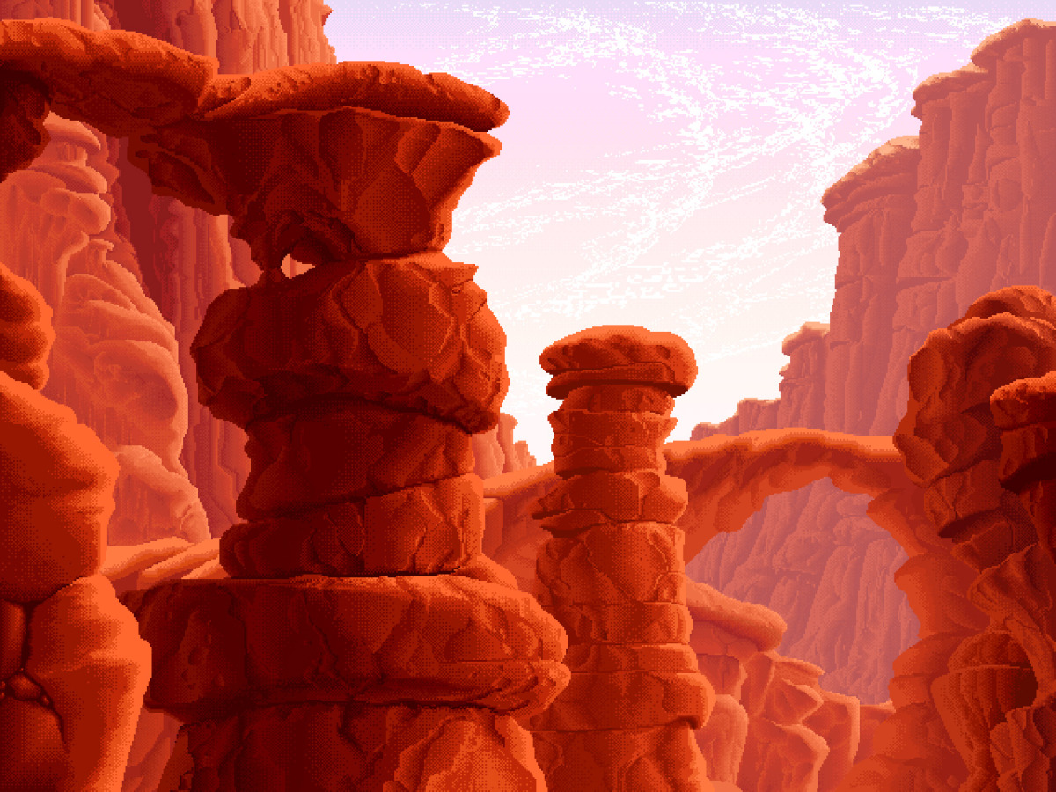
Inspiration
Not long ago I stumbled upon an excellent Game Developers Conference talk by Mark Ferrari who was of the prominent artists working for Lucasfilm Games in that time
https://www.youtube.com/watch?v=bRwHpU_kcPE (Excellent use of 1.5 hours if you find the time)
Mark talks about some of his experiences working as an artist with only those 8 colours, and then moving on to 8 bit art which gives you 256 colours
Images from : http://markferrari.com/art/8bit-game-art/
All done with a 256 colour palette (unique to each image) and clever use of dithering

Slide 6
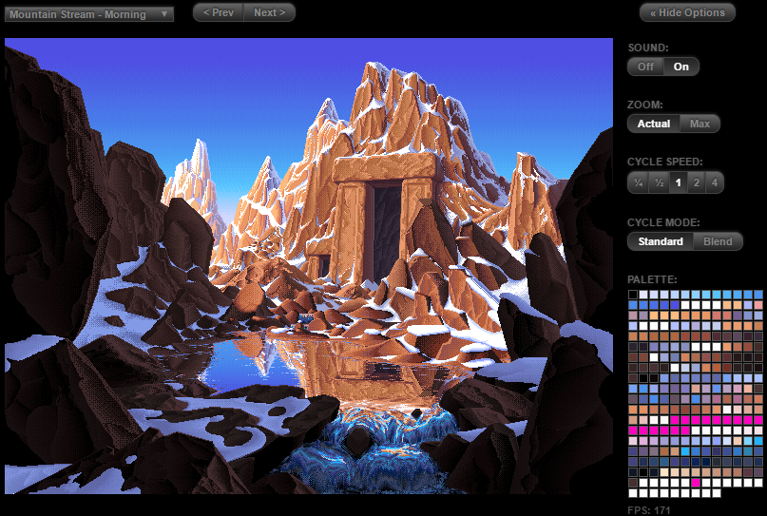
Mind Blown
He went on to show off something that I cannot at all do justice in a slideshow so here’s a link: http://www.effectgames.com/demos/canvascycle/
By not changing the actual image at all, merely swapping out the palette you can actually produce animations
Here’s a still but I highly suggest you check it out in it’s full glory on the site
There’s a whole gallery of these wonderful pieces

Slide 7
My Project
So what did I actually do with this idea?

Slide 8
It’s a piece of software that…
Takes any input image
Reduces it’s colour palette (either creating a dynamic palette or using a given one)
Produces an image using only that palette and different dithering algorithms to improve the result

Slide 9

About This Presentation
I’m going to break the rest of this presentation into two main parts:
Technical Details
This will explain the algorithms I used and some of the properties of each
You will be seeing a lot of this picture:
Her name is Lenna (https://en.wikipedia.org/wiki/Lenna)
This picture has become the de facto image in computer graphics to perform all kinds of image processing algorithms
I’ve used the same picture throughout for consistent comparisons
The Gallery
Here I will showcase this program by applying the techniques to various pieces of art for different artistic effects

Slide 10
Technical Details
How it all works

Slide 11
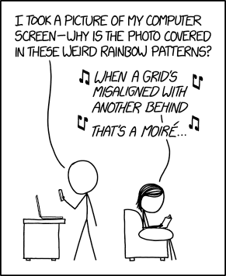
Disclaimer
A lot of these pictures don’t display well in PowerPoint because I can’t control the scaling. If you start seeing Moiré patterns please look at the source images provided (filenames referenced) in a photo viewer where you can view them at 100% size or scaled without blurring.
https://xkcd.com/1814/

Slide 12
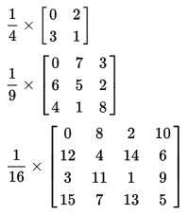

First Step: Black & White Ordered Dithering
This is done with what’s known as a Bayer Matrix (closely related to the Bayer Filter) that is laid over the whole image in a repeating pattern
These can come in various sizes
Essentially you map the [0, 255] greyscale value into the range [0, # cells – 1] depending on the matrix you’ve chosen (i.e. [0, 15] range for the 4x4 matrix)
If that value is greater than the Bayer Filter value assigned to that pixel, then the pixel will be white, otherwise it will be black
A simple gradient using the 4x4 filter produces a pattern like this: (image credits: https://en.wikipedia.org/wiki/Ordered_dithering)

Slide 13
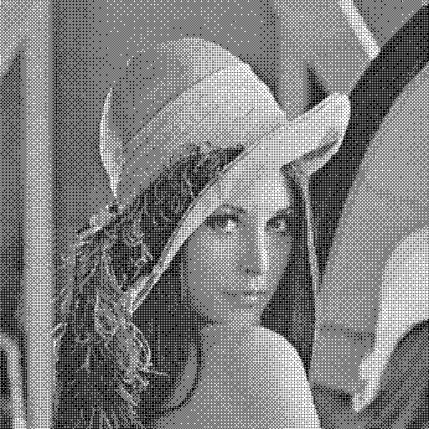
My Results
Original Greyscale
originals/lenna-greyscale.png
8x8 Ordered B&W Dither
dithered/lenna-bw-8x8.png

Slide 14
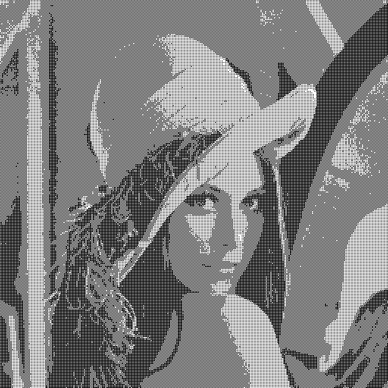


2x2 Ordered B&W Dither
dithered/lenna-bw-2x2.png
3x3 Ordered B&W Dither
dithered/lenna-bw-3x3.png
4x4 Ordered B&W Dither
dithered/lenna-bw-4x4.png
As you can see, the image gets clearer as you increase the size of the matrix, increasing the number of reproducible colours by the dither
8x8 Ordered B&W Dither
dithered/lenna-bw-8x8.png

Slide 15
Adding Colour
The first step in adding colour is creating a palette
I’ve manually defined a few simple palettes like EGA16 and a set of primary and secondary colours, but custom palettes will produce much better results
I decided to use K-Means Clustering (https://en.wikipedia.org/wiki/K-means_clustering) to determine the palette of N colours (N is configurable)
This algorithm starts with N random cluster centers and gradually refines these clusters to determine how to best classify all of the colours in the image into N groups
The algorithm is simple, elegant, and effective so give the wiki a read some time
Once we have this palette, we find the two closest colours in the palette for each pixel of the image
I use a k-d tree for faster palette look ups (https://en.wikipedia.org/wiki/K-d_tree)
We use the distance from each colour to determine how much of each colour to blend
Finally, we use the same Bayer Filter described previously and the blend amounts we just calculated to determine which of the two colours to use for that pixel

Slide 16


My Results
16 Colour Palette
palettes/lenna-16c-palette.png
Original
originals/lenna.png
16 Colour Reduced (No Dither)
dithered/lenna-16c-r.png
16 Colour 8x8 Ordered Dither
dithered/lenna-16c-8x8.png

Slide 17
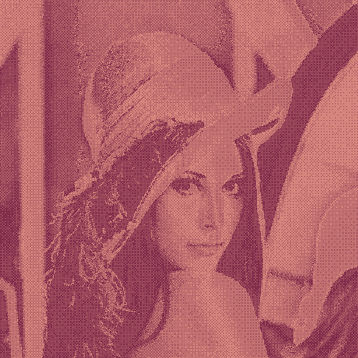
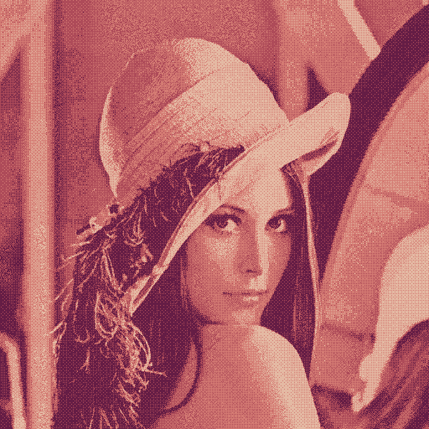
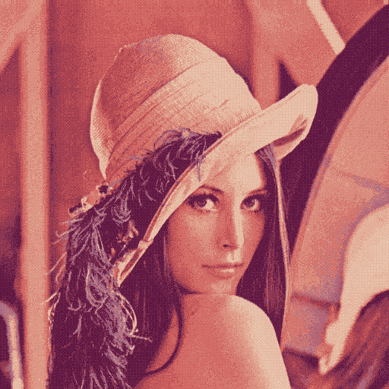
2c Ordered 8x8 Dither
dithered/lenna-2c-8x8.png
4c Ordered 8x8 Dither
dithered/lenna-4c-8x8.png
8c Ordered 8x8 Dither
dithered/lenna-8c-8x8.png
As you can see, the colours become more and more accurate as we increase our palette size. And with only 16 colours it already looks really good!
16c Ordered 8x8 Dither
dithered/lenna-16c-8x8.png

Slide 18
More Accurate Colours?
So far all of the colours we’ve been working with have been in RGB space for comparing colour distances and blends
But our eyes don’t work exactly the same as RGB, so maybe a different colour space would produce better results
The Lab colour space is designed for just that. It’s 3 dimensions are Luminance (L), red-green (a) and yellow-blue (b), which are the same as our eyes
It is very similar to the Munsell colour system
One feature it strives for is colour uniformity, so a difference in Lab colour value should produce the same perceived difference in colour

Slide 19

My Results
16 Colour (Lab) Palette
palettes/lenna-16c-L-palette.png
16 Colour Palette
palettes/lenna-16c-palette.png
Original
Originals/lenna.png
16 Colour (Lab) 8x8 Ordered Dither
dithered/lenna-16c-L-8x8.png
16 Colour 8x8 Ordered Dither
dithered/lenna-16c-8x8.png
The differences are pretty subtle but I think you can tell that the reds in the face are a bit more accurate. Some contrast is lost however, and the image is definitely more noisy. Overall I was hoping for a better result from the Lab colour space but I think RGB performed better overall.

Slide 20
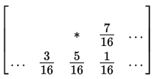
Floyd Steinberg Dithering
I also implemented a second type of dithering algorithm known as Floyd Steinberg dithering
This algorithm is part of a class of algorithms known as error diffusion algorithms
For each pixel in the image, you start by finding the nearest colour in the palette
Next you compute the error (i.e. the difference from the palette colour to original)
Then you distribute the error to the neighbouring pixels in different weighted amounts as shown in the picture (the current pixel is the *)
The weightings are different for different error diffusion algorithms, but the Floyd Steinberg weighting is the most common
Picture credits (https://en.wikipedia.org/wiki/Floyd%E2%80%93Steinberg_dithering)

Slide 21
My Results: Black & White
Moiré Alert!
(look using different photo viewer)
Original
Originals/lenna.png
B & W Floyd Steinberg Dither
dithered/lenna-bw-FS.png
B & W 8x8 Ordered Dither
dithered/lenna-bw-8x8.png
The Floyd Steinberg does great here. Clearly better than the 8x8 ordered dithering. There is far better contrast and detail. The dithering has far less noticeable patterns. Overall it’s just much more pleasing to the eye.

Slide 22

Now with colour
16 Colour Palette
palettes/lenna-16c-palette.png
Original
Originals/lenna.png
16 Colour Floyd Steinberg Dither
dithered/lenna-16c-FS.png
16 Colour 8x8 Ordered Dither
dithered/lenna-16c-8x8.png
Both dithering algorithms are using the same calculated 16 colour palette, but as you can see, the 8x8 ordered dithering definitely beats the Floyd Steinberg. There is quite a lot of visible banding and more noise overall with odd colour speckles. This was quite surprising as it did so well on the black and white test.

Slide 23
Why is this?
The reason lies in the algorithm
The Floyd Steinberg algorithm passes off the error onto neighbouring pixels, relying on them to correct the error in the future
For example, if the closest colour in the palette is too blue, then it will subtract blue from the neighbouring pixels, so they will be less blue to compensate
This will then average out in the viewers eyes and result in the correct amount of blue
The problem here is that the palette we’ve chosen is too narrow, when the error gets passed on, there are no other colours in the palette than can accommodate that error
And so as a result you get large bands where no error is accounted for, followed by weird coloured speckles to overcompensate once the error balloons and pops

Slide 24

Can I fix this?
24 (16 + 8) Colour Floyd Steinberg Dither
dithered/lenna-24c-FS.png
I attempted to fix this problem by adding some more colours to the palette to help deal with this accumulated error
I added Red, Green, Blue, Cyan, Magenta, Yellow, Black, and White in an attempt to cover all my bases
The result was better on average, but there was still far too much random speckling
Floyd Steinberg simply doesn’t perform well with this type of palette

Slide 25
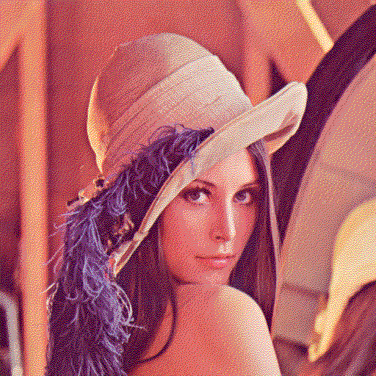
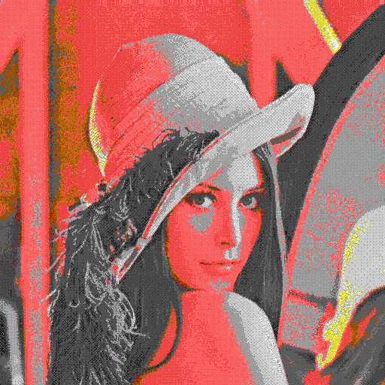
Using a varied palette
EGA16 Palette
palettes/ega16-palette.png
Original
Originals/lenna.png
EGA16 Floyd Steinberg Dither
dithered/lenna-ega16-FS.png
EGA16 8x8 Ordered Dither
dithered/lenna-ega16-8x8.png
Both dithering algorithms are using the same EGA16 colour palette, and as you can see, the Floyd Steinberg now far outperforms the 8x8 ordered dithering. The 8x8 ordered dithering can’t deal with such a wide palette, and it fumbles. In contrast, this is where the Floyd Steinberg algorithm shines. It is worth noting however that the custom 16 colour palette using 8x8 ordered dithering is better than both of them, but computing palettes takes a long time, and speed can be important.

Slide 26
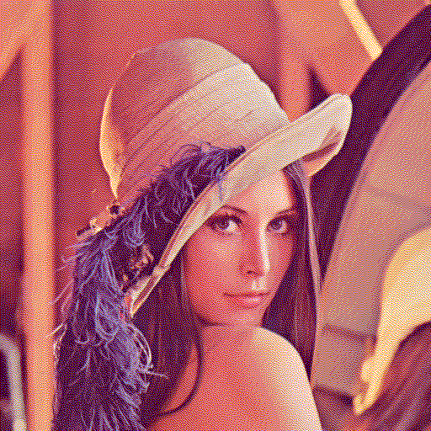
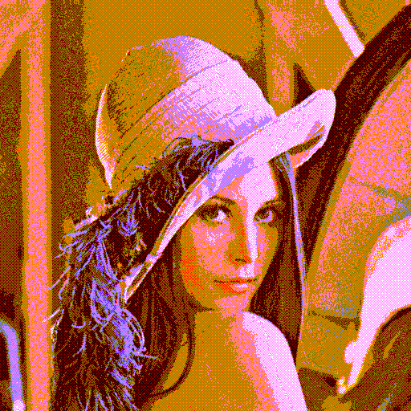
Using a bad palette
Blueish Palette
palettes/blueish-palette.png
Original
Originals/lenna.png
Blueish Floyd Steinberg Dither
dithered/lenna-blueish-FS.png
Blueish 8x8 Ordered Dither
dithered/lenna-blueish-8x8.png
Both dithering algorithms are now using a palette that is more skewed towards blueish tones. The original image is clearly a very red-orange image so this is a bad palette selection. However the Floyd Steinberg still does pretty good. It’s more blue than it should be but that’s expected. The 8x8 ordered dithering is again pretty bad

Slide 27

Summary
The top performer in colour is the 8x8 ordered dithering with a custom palette
An honourable mention goes to Floyd Steinberg for doing well with a totally inappropriate palette
EGA16 was the cause of many artists’ rage back in it’s day and Floyd Steinberg does very well with it
Floyd Steinberg takes first place in black and white dithering with a good margin
Black and white ordered 8x8 dithering still performs respectably
Goobye Lenna
Moral: Chose the right dithering technique for the right job

Slide 28
The Gallery
Having fun with what we’ve built

Slide 29
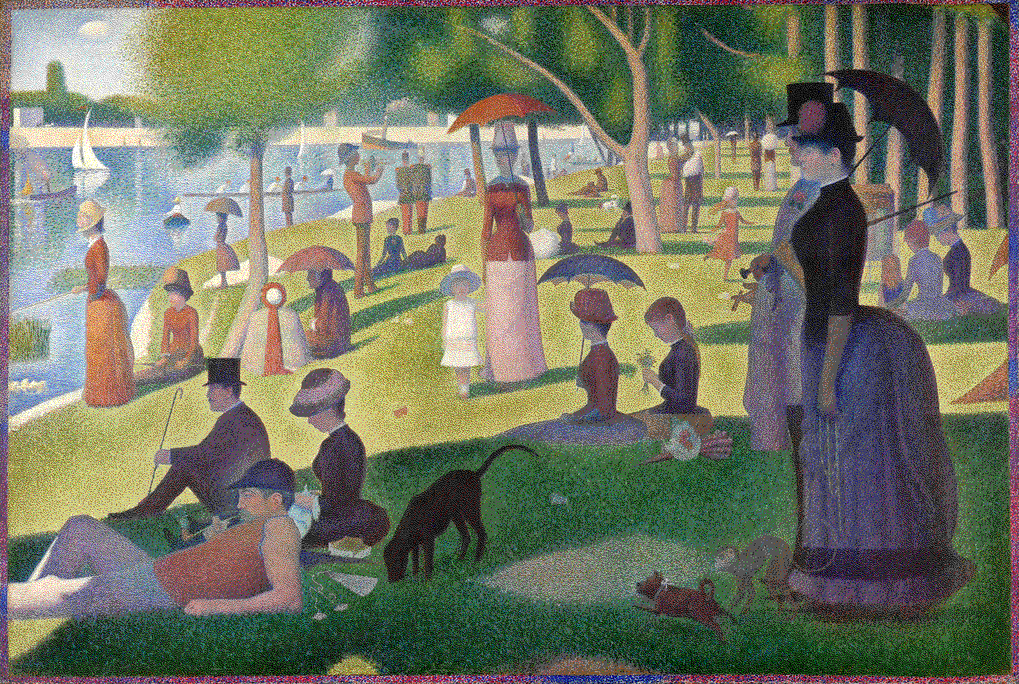
Pixelism (dithered/sunday-ega16-FS.png)

Slide 30
Pixelism Explained
Original: A Sunday Afternoon on the Island of La Grande Jatte, Georges-Pierres Seurat 1884-1886
This was one of the pieces I was most excited to do. Dithering is sort of like a modern version of pointillism so it seemed like the perfect piece.
I used the EGA16 colour with Floyd Steinberg dithering. The image has such a wide colour range that EGA16 does a great job representing it, and the more random nature of the noise really captures that pointillism aesthetic.
palettes/ega16-palette.png

Slide 31
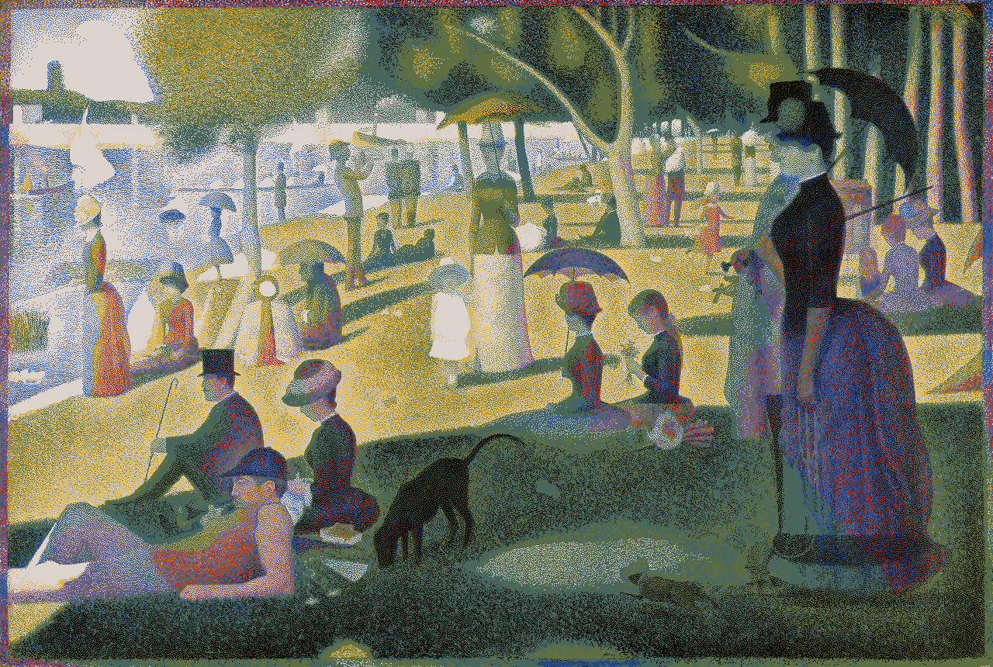
Palette de Seurat (dithered/sunday-seurat-FS.png)

Slide 32
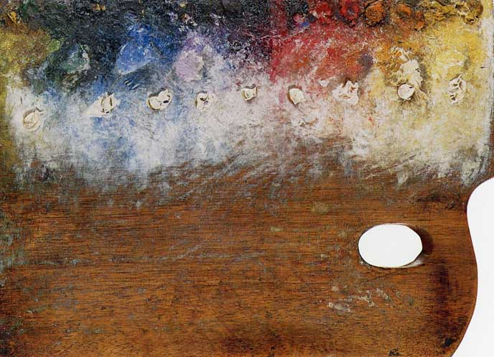
Palette de seurat Explained
Original: A Sunday Afternoon on the Island of La Grande Jatte, Georges-Pierres Seurat 1884-1886
Inspired by this image of Seurat’s palette I decided pick out some of the main colours in the picture and use that as a palette for the same piece.
I used this 16 colour custom palette with Floyd Steinberg dithering. The palette was still pretty varied and this kept with the pointillism style better.
The result is a much sadder looking piece with more muted colours and a green wash to all the shadows. Perhaps Seurat was just sad the day he was painting with this palette.
palettes/seurat-palette.png

Slide 33
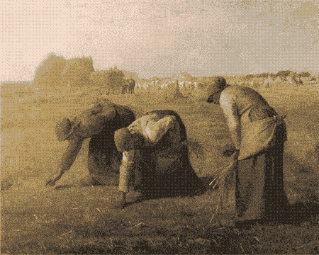
Muted (dithered/millet-8c-8x8.png)

Slide 34
MUTED Explained
Original: The Gleaners, Jean-François Millet 1857
I wanted to do a French realism painting that really emphasized the dull colour palette. I found that a small dynamic colour palette has a tendency to make the colours very muted.
And this definitely turned out to be the case. Just looking at that palette image alone is depressing.
This image used 8x8 ordered dithering to best deal with the narrow palette
palettes/millet-8c-palette.png

Slide 35
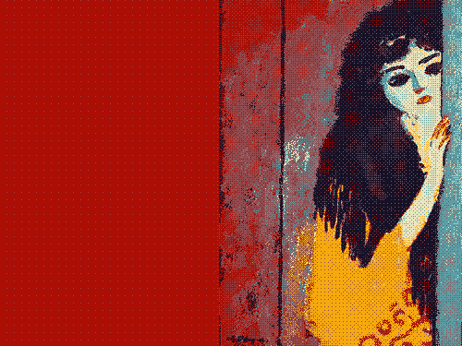
Pixy (dithered/gypsy-6c-8x8.png)

Slide 36
Pixy Explained
Original: Gypsy, Cornelis Theodorus Maria 'Kees' van Dongen 1910-1911
If you look at the original there are really only 6 main colours used. So naturally a 6 colour dynamic palette would work perfectly.
Looking at that palette tells you the entire colour story of the painting. It’s really a testament to how pure a fauvist painting it is. Six high intensity colours can paint the whole thing.
This image also used 8x8 ordered dithering to best deal with the narrow palette
palettes/gypsy-6c-palette.png

Slide 37
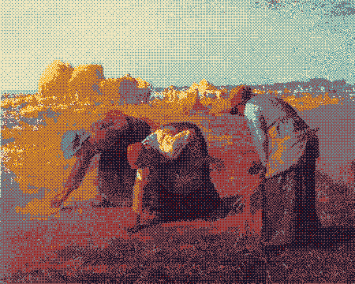
Brought to Life (dithered/millet-gypsy-8x8.png)

Slide 38
Brought to Life Explained
Original: The Gleaners, Jean-François Millet 1857
I thought it would be interesting to swap the colour palette of a fauvist painting and French realism painting. I wondered how much it would change the tone of the image.
Unsurprisingly it changes it entirely. The fauvist palette really brings these women to life.
This image used 8x8 ordered dithering to best deal with the narrow palette
palettes/gypsy-palette.png

Slide 39
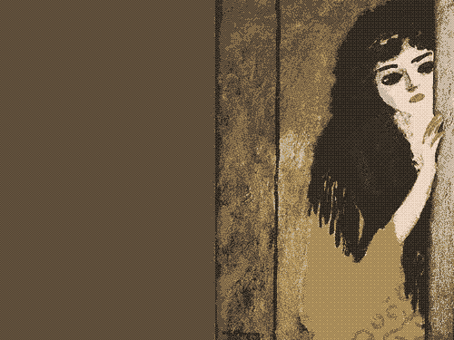
Silenced (dithered/gypsy-millet-8x8.png)

Slide 40
Silenced Explained
Original: Gypsy, Cornelis Theodorus Maria 'Kees' van Dongen 1910-1911
Continuing the swap I brought the French realist palette to the fauvist painting.
The expression of the gypsy’s face seems to change with the colours. She, like her palette, has been silenced.
This image also used 8x8 ordered dithering to best deal with the narrow palette
palettes/millet-palette.png

Slide 41
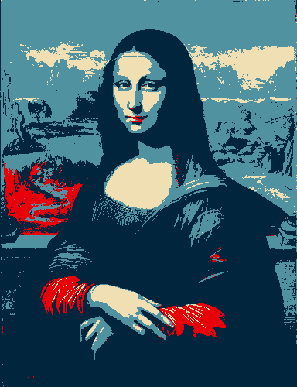
Change (dithered/mona-lisa-obama-r.png)

Slide 42
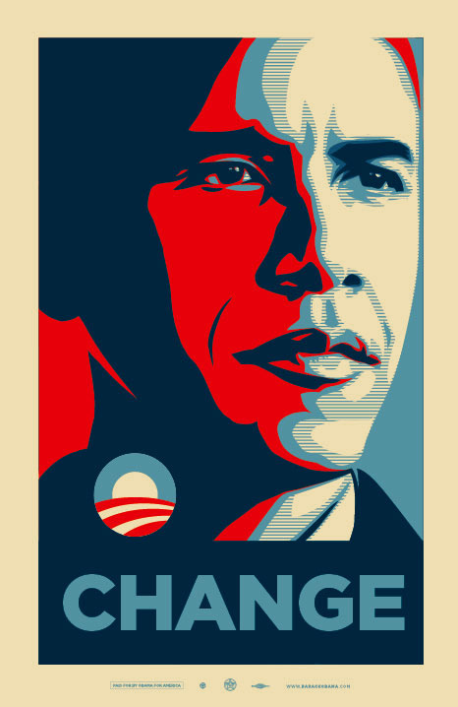
CHANGE Explained
Original: Prado Museum La Gioconda, Pupil of Leonardo DaVinci, circa 1500
I thought it might be interesting to combine two of the world’s most famous portraits. I did use a copy instead of the original Mona Lisa because it started out with a more suitable colour palette.
Inspired of course by the well known Obama “CHANGE” posters and their iconic palette.
This image used a colour reduction with no dithering to stay true to the original.
palettes/obama-palette.png

Slide 43
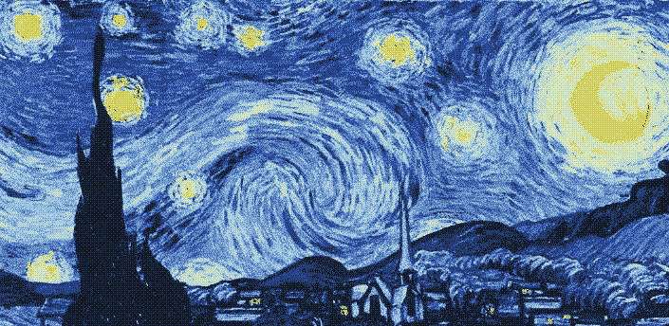
The Starry Knight (dithered/gypsy-millet-8x8.png)

Slide 44
The Starry Knight Explained
Original: The Starry Night, Vincent van Gogh, 1889
I decided to finish this gallery off with one of my all-time favourite paintings. I first ran it through an 8 colour reduction without dithering, and I was impressed how good it looked. It came out unscathed, a starry knight.
I did notice one subtle quality was missing though. The impasto texture had disappeared.
I was able to bring some of that texture back with and 8x8 ordered dithering, and lift it off the canvas again.
palettes/starry-night-8c-palette.png

Slide 45
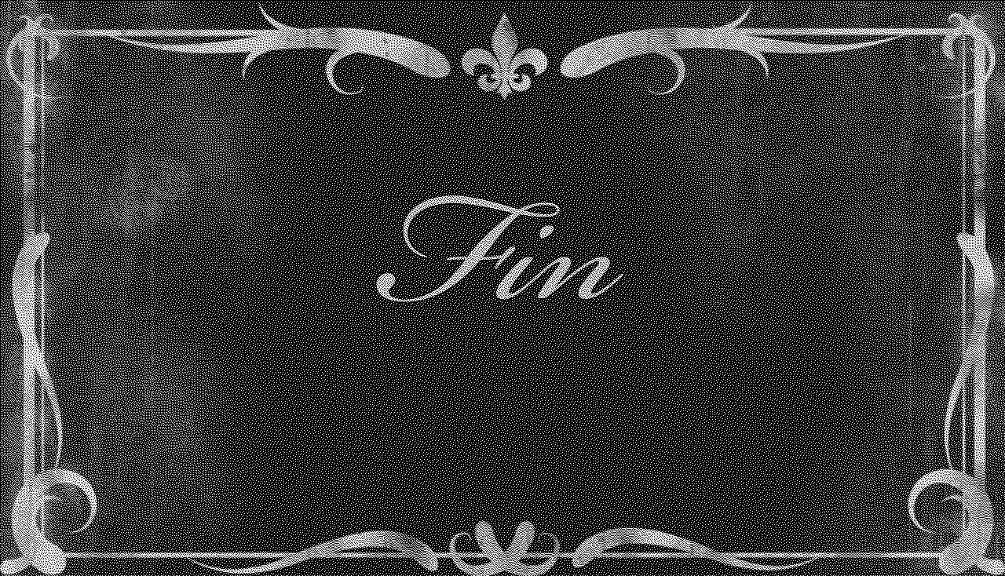
(dithered/fin-bw-FS.png)
Thanks for reading!

